Slide 1









Telephone Directory

Slide 2



The team
Ashika
Raghul Gandhi.R
CB.EN.U4CSE21249
CB.EN.U4CSE21249

Slide 3





Problem Statement
Phone Directory Management System with Sorting and Customized Search

Slide 4




Problem Description
Our goal is to develop a phone directory management system that allows users to store and manage their contacts efficiently. The system should provide functionality for inserting, updating, deleting, and deleting all contacts. Additionally, the system should support sorting contacts alphabetically and enable users to fetch contact details by specifying the attribute and value of their choice.

Slide 5






Practical Application
Its purpose is to allow the telephone number of a subscriber identified by name and address to be found.
It can be used as a Information Book of people as it contains many data of them.

Slide 6

Approach to the Problem
Using Linked List Data Structure:
To address the phone directory management problem, we have implemented a linear data structure called a linked list. The linked list consists of nodes, where each node represents a single contact in the phone directory.

Slide 7
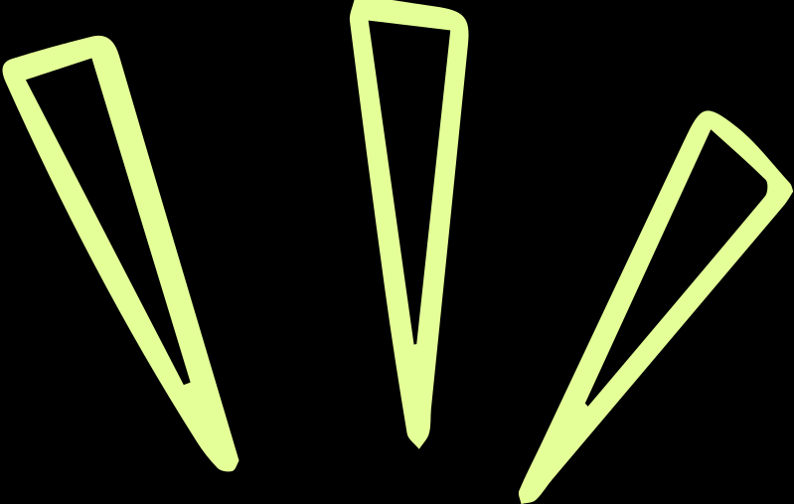



Linked List

Slide 8

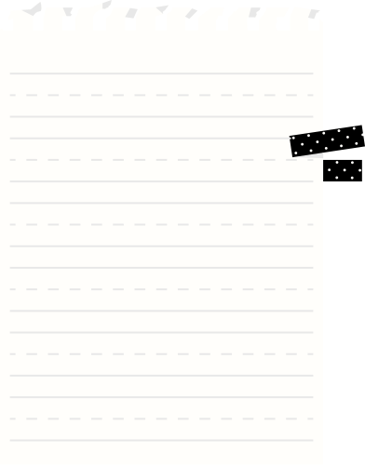
Operations Used
1
2
3
Insertion
Updation
Deletion
- We maintain a pointer called `head` that points to the first node in the linked list.
- When a user wants to add a new contact, we create a new instance of a contact class that holds the contact's details.
- We then insert this contact if it the first one then self.head, means first node itself. And if adding the contacts to an existing phone directory then to the end of the linked list by updating the `head` pointer.
- To update a contact's details, we traverse the linked list starting from the `head` node.
- For each node, we compare the name (in lowercase) with the user's input.
- If a match is found, we update the value of the desired attribute (e.g., phone number, email address) with the user's provided input.
- To delete a specific contact, we traverse the linked list starting from the `head` node.
- We compare the name of each contact with the user's input.
- If a match is found, we remove that particular node from the linked list by adjusting the links between adjacent nodes.

Slide 9
Stack

Slide 10

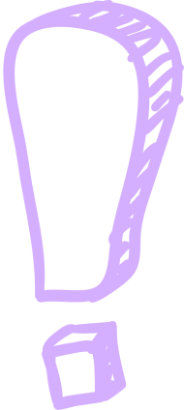


Used for storing contacts.
Itpush and pop the contacts including name and number

Slide 11


THANK YOU

